Slide 1
Dell Networking
Gino Guidi
Network Solutions Architect
Notes:
What follows is the Networking Solutions Business Decision Maker Deck

Slide 2



The Network has taken the center stage
Business is placing more demands on the network than ever before
Too many layers, devices and operating systems make management needlessly complex.
Mobility requires secure access to go where business is located
Notes:
It’s no surprise that networking for businesses continues to change. Regardless of the size of the company or the business vertical, three commonly identified “beliefs” hold true:
The business is relying on the technology and network to contribute to success. This means more demands are being placed on the network.
Too many layers, devices and operating systems make management needlessly complex.
On top of it all, there is a scalability issue where the network must scale to service a heterogeneous user audience accessing more mission critical apps, on more devices, from more places…including the campus, branch or remote offices as well as users that are on the road.

Slide 3

A Change In Approach
Transformation
Dell solutions strategy relies on Networking as the foundation
Status Quo
Notes:
Major points
It is no accident that Dell “happened upon” networking – businesses depend on it today more than ever before
Why us? Because we occupy a unique area in the market
Why now? – because intelligence is moving from the laptop to the network. The rules of the game are changing and the incumbent is no longer granted a shoe in. We have uniqueness to take advantage of market conditions.
Market conditions + trends + our advantage = the Dell choice

Slide 4






IT Trends and Challenges Changing network paradigm
Diverse audience
Unclear network perimeter
Multiple devices
Blending of applications
Employees
Partners
Outsourcers
Guests
Datacenter
Campus
Branch
Remote
PCs & Laptops
Tablets
3rd Party
Smartphones
Peripherals
Mission critical
Converged
Cloud-based
Storage
Notes:
MAIN MESSAGE:
In contemplating virtualization in particular and the network in general, there are several key challenges we must acknowledge and plan for in order to architect the network for the business ahead.
CLICK! First, there are more users. Because of the mobility of these users, an CLICK! organization’s network must scale further than ever before. CLICK! These users are also accessing the network with multiple devices, from traditional, corporate-issued PCs and laptops, as well as from third-party and unmanaged endpoint devices like tablets and smartphones.
CLICK! And finally, there are also more mission-critical applications than ever before; and today, many of them are housed in the cloud. This requires a network not only to scale to different users at different locations on different devices, but also to do so in a way that end-users have an LAN-like experience with complete security, regardless of their location.

Slide 5


What networking concerns are on the IT Managers mind?
Concerns around Networks
Affordability
Dependability
D
A
Best-in-class
B
Ease-of-use
E
Compatibility
C
Notes:
What networking concerns are on the IT Managers mind?
Affordability – building a new network from scratch is expensive.
Best in Class – Reliability and performance - I find it complex and I am not sure what products to include the solution that fits my needs and framework.
Compatibility – How do I know that all these products are compatible and that the solution is scalable.
Dependability - Dell provides a complete portfolio of products providing ultimate flexibility and interoperability, including mobility solutions.
Ease-of-use - Similar Command Line Interface (CLI) to Industry Standard Product Offerings: Minimal learning curve for fast deployment
Another aspect is that we’re all familiar with cloud and virtualization initiatives. Adding to the complexity and increased demand we mentioned previously, the network must scale to anywhere where business is done… from the data center… to campus locations… to remote facilities… to the mobile workforce. Everything we do needs to scale everywhere - and the center of gravity is the datacenter.
This is the basis out our discussion today – specifically the of how to solve for the increased demands being placed on the network in a way that is efficient, while also answering the current and future demands that will be required of the network.

Slide 6
How many can you define?
MAC
FTOS
Backbone
EIGRP
Convergence
RTP
DVMRP
LAN
ASIC
VSS
802.1P
MBONE
VOIP
Trunking
PIMv2
Layer 4
BGP
ACL
Latency
ETS
DR
RP
ARP
Telnet
PFC
BCAST Storm
PIM
VLT
Hello Timers
Proxy ARP
CLI
IGMP Snooping
PIM-SM
Access
CIDR
OSPF
MIB
VLAN
TRILL
CNA
FCoE Transit
CAM
IGMP
Spanning Tree
SPF
SSM
CDP
VRF
IGP
FCoE
NTP
vPC
Querier Timers
MOSPF
GRE
MAC Table
TTL
Layer 2
RTT
EGP
DCB
SSH
MCAST Pruning
VxLAN
TCP
STP
QoS
Queuing
IPv6
RFC 1918
RIP
IGRP
RIPv2
NV-GRE
Core
UDP
SNMP
LACP
DCBx
802.1Q
Neighbor Discovery
Layer 3
Keep Alive Timer
Notes:
Interactive Exercise
This is a simple pop quiz for those in the audience. Ask audience to raise hands if you could explain what the networking terms that flashes on the screen means. The point is to have the audience acknowledge by the end of the build
that it demands specilaist skills to build a network correctly that optimizes all components in your environment.
Dell can help!
Acronym Cheat Sheet:
802.1P – IEEE workgroup focused on adding traffic class expediting traffic (prioritization)
802.1Q - IEEE working group defining virtual LANs on an Ethernet network Access Layer - Also known as Layer 1 of the OSI model
ACL- Access Control List
ARP – Address Resolution Protocol
ASIC – Application Specific Integrated Circuit Backbone - Term used to describe the connections between various elements of a network
BCAST Storm - an event in a network where broadcast traffic overwhelms switches or hosts with broadcast packets
BGP - Border Gateway Protocol
CAM Table - Content Addressable Memory Table
CDP - Cisco Discovery Protocol
CIDR - Classless Inter-Domain Routing
CLI – Command Line Interface
CNA – Converged Network Adaptor
Convergence - A term used to describe the coming together of multiple things; for example converging of storage protocols like iSCSI, FC & Ethernet. Also used for Voice, Video & Data. Core - Usually the center of a network that connects multiple network segments together
DCB - Data Center Bridging
DCBx - Data Center Bridging eXchange
DR – Designated Router
DVMRP – Distant Vector Multicast Routing Protocol
EGP - Exterier Gateway Protocol
EIGRP – Enhanced Interior Gateway Routing Protocol
ETS - Enhanced Transmission System; defined in 802.1Qaz
FCoE - Fibre Channel over Ethernet
FCoE Transit - A technique of transporting Fibre Channel over Ethernet without interacting directly with the Fibre Channel Fabric
FTOS – Force 10 Operating System
GRE - Generic Route Encapsulation Hello Timers - A timer used by various protocols to announce
IGMP – Internet Group Management
IGMP Snooping – Layer 2 method of identifying multicast requests
IGP – Interior Gateway Protocol
IPv6 - Internet Protocol version 6 Keep Alive Timer - a timer that is set to indicate that a given device is active
LACP - Link Aggregation Control Protocol
LAN – Local Area Network Latency - Networking time term used to describe the time it takes a packet to be delivered via a particular system usually measured in sub second intervals
Layer 2 - Also known as the Data Link Layer in the OSI Model
Layer 3 - Also known as the Network Layer in the OSI model
MAC – Media Access Control
MAC Table - Media Access Control Table
MBONE - Multicast Backbone was an experimental Internet dedicated to multicast applications
MCAST Pruning - Multicast pruning is removing portions of the mcast tree after timers have expired
MIB - Management Information Base
Neighbor Discovery - Term in networking to describe the understanding of an adjacent switch or router (depending on the protocol)
NTP – Network Time Protocol
NV-GRE - Network Virtualization using Generic Routing Encapsulation
OSI - Open Systems Interconnection effort by the International Organization for standardizing an abstraction model for communication systems
OSPF – Open Shortest Fast First (routing protocol)
PFC - Priority Flow Control; defined in 802.1Qbb
PIM-SM - Protcol Independent Multicast Sparse Mode
PIMv2 – Protocol Independent Multicast (version 2)
Proxy ARP - Proxy Address Resolution Protocol, a technique of resolving a request on behalf of another device (proxy)
QoS – Quality of Service
Querier Timers - Term used in multicast and other protocols to describe the time between queries
Queuing - method of organizing traffic into queues in network devices
RFC 1918 - Request for Comment publication of the "Private network blocks" such as 192.168.0.0/24 or 10.0.0.0/8
RIPv2 - Routing Information Protocol version 2
RP - Rendezvous Point
RTP - Real Time Protocol
RTT - Round Trip Timer
SNMP – Simple Network Management Protocol
SPF – Shortest Path First
Spanning Tree – A term used to create a “tree” of network switches and resolve loops.
SSH - Secure SHell
SSM - Source Specific Multicast
STP – Spanning Tree Protocol
TCP - Transmission Control Protocol
Telnet - is a network protocol used on the Internet or local area networks to provide a bidirectional interactive text-oriented communications facility using a virtual terminal connection Trunking - Term used in networking to take smaller links and aggregate into a larger virtual Link
TRILL - Transparent Interconnect of Lots of Links
TTL - Time to Live
UDP – User Datagram Protocol
VLAN - Virtual Local Area Network
VLT - Virtual Line Trunking
VOIP - Voice over Internet Protocol
VRF – Virtual Routing & Forwarding
VSS - Virtual Switch System
VxLAN – Virtual eXtensible Local Area Network – enabling virtualization-aware Networks that can be encapsulated over Layer 3 infrastructure

Slide 7
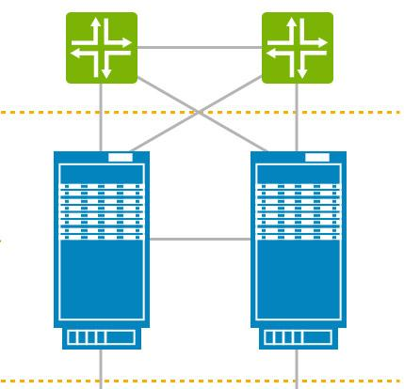
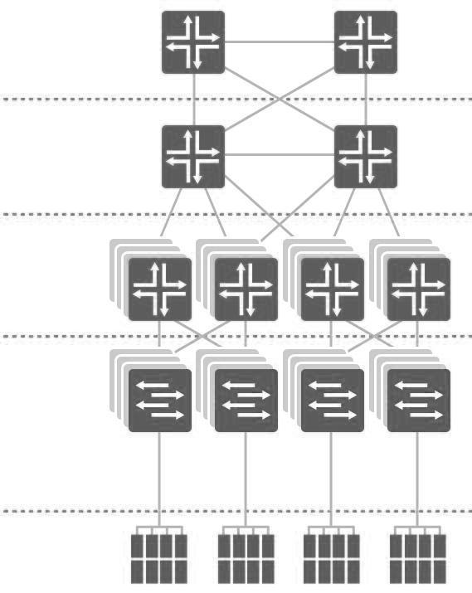
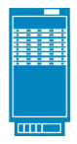
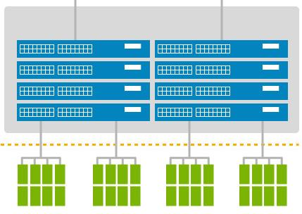
Simplify the network through design
Consolidated Network Design
Traditional Network Design
WAN Interface
Less to buy
Less to manage
Less real estate, power & cooling
Tier 1
Core
Tier 2
Aggregation
Security
Storage
Virtual Stack & Management
Tier 3
Access
Servers
Notes:
Users want to simplify their networks – Dell’s approach is to simplify and streamline
Dell can help you address your current challaneges while alos reducing costs, streamlining cumbersome processes and improving performance. We do this by deploying best-in-class networking solutions based on their exact needs and topology.
Here we are looking at an Traditional network solution.
CLICK
1. In the simplification process, we streamline your network by reducing the number of layers and “boxes” in your network topology, you can achieve a smaller footprint, lowering both capital and operational expenses. We look at a customer’s network and reduce the switched environment with virtual chassis technology. This can reduce their access-layer-switched-environment by as much as a factor of ten to one.
2. Further, collapsing the core and aggregation layers dramatically reduces latency and improves the end-user experience. It also reduces the amount of gear necessary, which means there is less to manage, less to house and less to power and cool.
And finally, based on their unique requirements and by utilizing our advanced services capabilities, we can make specific recommendations on how they can improve resiliency and transparent failover…and even help them reduce risk by adding or augmenting their existing security and archiving infrastructure into the solution.

Slide 8
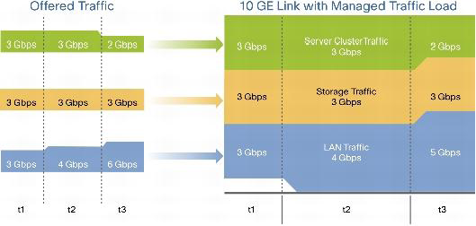
10Gb D.C.B. - Data Center Bridging
DCB is a set of standards to enhance Ethernet for
the data center use (10Gb or higher)
IEEE Standards:
PFC – Priority-based Flow Control (802.1Qbb)
ETS – Enhanced Transmission Selection (802.1Qaz)
CN – Congestion Notification (802.1Qau)
DCBX - Data Center Bridging capability eXchange (802.1Qaz)
Notes:
P802.1Qaz: Enhanced Transmission Selection (ETS) enables transmission bandwidth management and ratelimiting per traffic class. ETS allows traffic classes to use spare bandwidth above the guaranteed minimum. ETS provides common management of bandwidth allocation on a per priority group basis. Switches that claim support for DCB, should allow configuration of priority groups, assignment of individual classes of service to each group and the allotment of per-port bandwidth to each group.
P802.1Qbb:Priority-based Flow Control (PFC) enables multiple traffic types to share a common Ethernet physicallink without interfering with each other. PFC allows link flow control to be performed on a perpriority basis. Priority-based Flow Control (PFC) provides a link level flow control mechanism that can be controlled independently for each priority queue. PFC provides a link level flow control mechanism that can be controlled independently for each frame priority class of service. Switches that claim support for DCB should provide mechanisms for assigning a class of service to different
DCBx iSCSI Application Type-Length-Value (TLV): Dell has recently added this application TLV, which provides the primary mechanism for communicating capabilities from switch-toswitch or switch-to-edge device node within the DCBx protocol. This is an extension to the 802.1AB LLDP protocol. Of particular need is the support for an application TLV that supports the TCP well-known port 3260 (iSCSI).

Slide 9
Enhancements to Ethernet,
HALT an individual stream, but NOT all of them!
Allocate bandwidth based upon predetermined classes of traffic
802.1Qbb
(Per-Priority Flow Control)
802.1Qaz
(Enhanced Transmission Selection)
IEEE
DCB
IEEE
DCB
5G
3G
10GbE
Link
10GbE
Link
4G
4G
1G
3G
t₁
t₂
IEEE
DCB
802.1Qau
(Congestion Management)
TRILL
(Ethernet Multi-Pathing)
IETF
TRILL
X
STP
TRILL
X
End-to-End Communication between end-points.
Multi-pathing for Ethernet
Replaces Spanning Tree
Notes:
Figure A: P802.1Qbb:Priority-based Flow Control (PFC) enables multiple traffic types to share a common Ethernet physicallink without interfering with each other. PFC allows link flow control to be performed on a perpriority basis. Priority-based Flow Control (PFC) provides a link level flow control mechanism that can be controlled independently for each priority queue. PFC provides a link level flow control mechanism that can be controlled independently for each frame priority class of service. Switches that claim support for DCB should provide mechanisms for assigning a class of service to different.
Figure B: P802.1Qaz: Enhanced Transmission Selection (ETS) enables transmission bandwidth management and ratelimiting per traffic class. ETS allows traffic classes to use spare bandwidth above the guaranteed minimum. ETS provides common management of bandwidth allocation on a per priority group basis. Switches that claim support for DCB, should allow configuration of priority groups, assignment of individual classes of service to each group and the allotment of per-port bandwidth to each group.
Figure C: 802.1Qau - Congestion Notification. This standard specifies protocols, procedures and managed objects that support congestion management of long-lived data flows within network domains of limited bandwidth delay product. This is achieved by enabling bridges to signal congestion information to end stations capable of transmission rate limiting to avoid frame loss. This mechanism enables support for higher layer protocols that are highly loss or latency sensitive. VLAN tag encoded priority values are allocated to segregate frames subject to congestion control, allowing simultaneous support of both congestion controlled and other higher layer protocols. This standard does not specify communication or reception of congestion notification information to or from stations outside the congestion controlled domain or encapsulation of frames from those stations across the domain.
Figure D: TRILL Transparent Interconnect of Lots of Links) is a IETF Standard [1] implemented by devices called RBridges or Routing Bridges. TRILL combines the advantages of bridges and routers and is the application of link state routing to the VLAN-aware customer-bridging problem. RBridges are compatible with and can incrementally replace previous IEEE 802.1 customer bridges. They are also compatible with IPv4 and IPv6 routers and end nodes. They are invisible to current IP routers and, like routers, RBridges terminate the bridge spanning tree protocol.

Slide 10
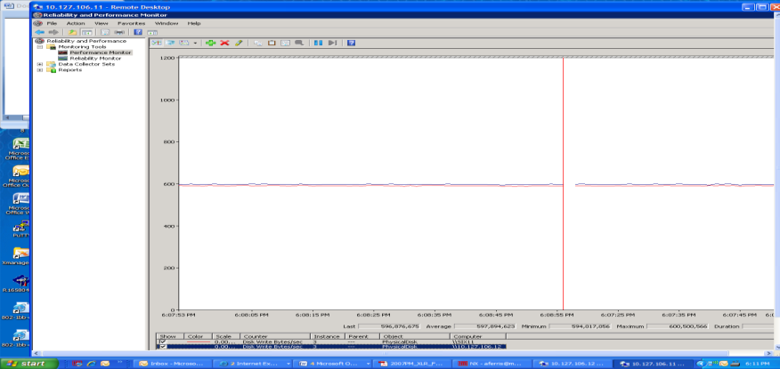
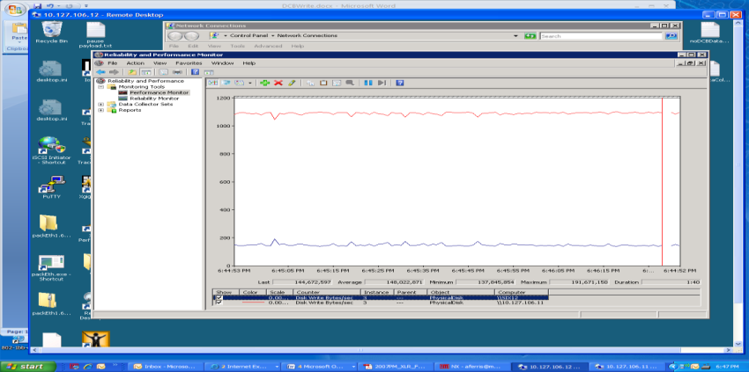
Preliminary DCB Results….
iSCSI WITH DCB
iSCSI WITHOUT DCB
10G
DCB SWITCH
NON-DCB
10G SWITCH
1
1
10G
10G
2
10G
2
10G
10G
10G
10GbE ARRAY
10GbE ARRAY
WINDOWS SERVER 2008 x64
10GbE CNA
DCB LINKs
(PFC)
WINDOWS SERVER 2008 x64
10GbE CNA
1
1
2
2
Balanced iSCSI throughput
(600MB/s, 600MB/s)
Unbalanced iSCSI throughput (1100MB/s, 100MB/s)
Notes:
Experimentation with DCB and non DCB
The following diagrams and screen shots shows just a simple case evaluation of using DCB and not using DCB for iSCSI traffic. The pathological case of two producing ports sending data to a single consuming port was configured (thus providing the 2:1 over subscription that would cause congestion at the switch egress port).
The raw data is not available, but we will generate this again in more time with more precise data being gathered (including retransmit counts, pause counts, precise throughput, CPU utilization, etc.)…
Executive Summary
DCB creates smooth throughput. The DCB throughput is flat. The non-DCB case shows choppy throughput.
DCB creates fair distribution. This is plainly obvious when looking at the non-DCB screenshot. The initiator started first wins the lion share of the bandwidth in the non-DCB test.
Throughput is roughly equivalent between the tests.
Test environment
All tests were done with iometer (2 volumes – one per initiator, 256K sequential writes, queue depth 32, to cache) over the Microsoft iSCSI initiator running with the Intel Niantic 10GE card. The throughput was shown with the Microsoft Reliability and Performance Monitor. In both tests, the same initiators and target were used. The only thing that changed between the tests was the switch. All links on the DCB test (all three) were DCB PFC enabled and on)
Conclusion
Generally, this is the result that was expected. More testing is required to fully understand the implications of DCB. This only gives us an idea about how DCB can help SAN traffic. And it creates more curiosity about other testing.
Other thing to note is that a 10GE link can drive ~1240MB/s throughput. Calculation is shown below.
Max throughput on 10GE (with 64/66 encoding)
= 10Gbps * (64/66)
= ((10*1024/8)MBps * (64/66)
= 1280MBps * (64/66)
= 1241.2121 MB/s

Slide 11
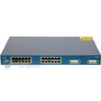
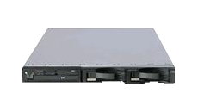
10Gb D.C.B. - Benefits
Convergence Ethernet
LAN, SAN & HPC
HPC
SAN
LAN
Convergence of applications and networks to use a single infrastructure
Switch (10GbE)
Adaptador (10GbE)
Different classes of traffic with different service guarantees
NIC
Servidor
Configuration of end-stations by switches through DCBX (switch to switch, not so much)
Mixed speed bridging (10GE to 40GE/100GE)
Notes:
What are the benefits to DCB:
1.- Convergence. All services will run using same networks and infrastructure with means reducing hardware and save CAPEX
2.- we can establish different services qualities.
3.- we have configuration end to end, not switch to switch as occurred before DCB
3.- We can mix different speed 10Gb now and 40 /100Gb in the future..

Slide 12


Value Proposition
Affordable
Simple to deploy
& manage
Supports standards
Best-in-Class
No vendor lock-in
Quality
Redundancy
Compatible
Open
Standards-based
Scalable
Dependable
End-to-end
Integration
Scalability &
Automation
Easy to use
Leverage existing investments
Notes:
CLICK! Affordable -
Dell’s open and innovative Networking solutions enable you to augment your existing infrastructure
Dell’s solutions leverage your existing infrastructure and training investment
Pay-As-You-Grow : Dell now provides complete Networking solutions for all your needs
1 , 10, 40 and 100 Gigabit Ethernet
Our products provide scalability to meet any customer requirement: Data Center, Campus, Branch, & Mobile Environment
You can buy a simple stackable switch to start and add as needed
Open architecture, standards based: Dell’s Networking products allow customers to leverage their complementary investments in server and storage products
Augment rather than “rip and replace” - Build on what you have
CLICK! Best-in-class
In a rapidly changing IT environment, investment protection becomes a critical concern.
Dell provides a complete portfolio of products providing ultimate flexibility and interoperability.
End-To-End Integration: Open standards-based solutions - Enables you to take back your Networking strategy
Performance, Scalability, and Automation for Next Generation Networks
Over 10 years of industry innovations, including 1, 10, 40 and 100 Gigabit Ethernet
Work “Better together” with our servers and storage - Like EqualLogic auto-detection and configuration
CLICK! Compatible -
Allows SMB Customers to take advantage of the latest industry innovations without integration concerns.
Cloud Computing and Virtualization are putting additional demands on the network.
Industry’s newest, innovative portfolio and software enabling Open Cloud Networking
Open Architecture
Open Automation
Open Ecosystem
Dynamically scales the network to meet virtualization needs for all locations
Open architecture enables network agility; No disruption due to “rip and replace
CLICK! Dependable
When we say reliable, we mean it. Some companies claim reliability, but do they really provide it?
Dell builds every component of the network to ensure quality and redundancy.
Industry Leading Support: Technical, warranty, and product support services that reduce the cost & complexity of owning and supporting Dell Networking products
Warranty: Products designed and developed in the most demanding quality control environment
Dell’s warranty programs are better than or at par with our competition
CLICK! Easy-to-use - Minimal learning curve
Similar Command Line Interface (CLI) to Industry Standard Product Offerings
Easy to install
Step-by-step installation
Plug & play configurability
Centralized management making it easy to set-up with storage & server products
Manage multiple systems through a single pane of glass
Supports standards-based 3rd party management systems
Web GUI-based management

Slide 13
Dell Networking portfolio positioning
Switching Capacity/Ports
Force10
High Capacity
1000’s of Ports
Medium Capacity
100’s of Ports
100Gb 40Gb 10Gb 1Gb
Next generation efficiency
Deliver convergence
Scale virtualization
PowerConnect
Anywhere access
Secure access & delivery
Manage policies & users
Low Capacity
10’s of Ports
DataCenter Size/Growth Potential
Notes:
With the acquisition of Force10, the Dell Networking Portfolio has changed dramatically. We can now offer best-in-class networking gear to meet the most simple or the most demanding of IT environments.
The PowerConnect classic line has historically been known for its overall value and cost per port. Dell PowerConnect features both layer 2 and layer 3 top-of-rack switches that range from entry level to mid-range with features like Equallogic Auto-Detect & iSCSI optimization. These switches fit well in remote or branch offices, as well as smaller environments where large port counts and high switching capacity are not the primary motivators. The PowerConnect line also fits great in small iSCSI storage environments where under three Equallogic arrays will be used as well as smaller Compellent iSCSI SAN environments.
For customers who have large datacenters today or have growth potential that requires a pay-as-you-grow approach, the Dell Force10 Family offers customers layer 3 switching options that range from top of rack to ultra-dense chassis and distributed core. The Force10 portfolio is the right choice for customers looking for over 150 1Gb ports, over 24 ports of 10Gb ethernet, or for customers who are aggregating many devices into a single core device for distribution and routing. Force10 also has next-generation technologies that accomodate customers who are looking for advanced functionality like ultra-low latency or large buffer capacity environments. Financial institutions and Web 2.0 companies often rely on these more advanced capabilities and have seen tremendous success using Force10 switches.

Slide 14
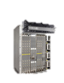
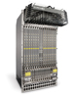
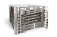
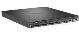
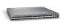
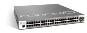
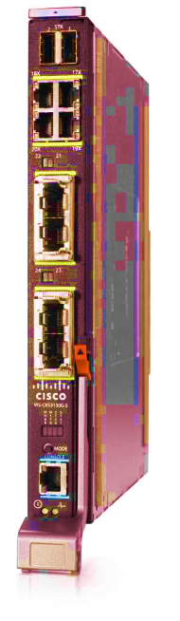
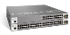
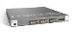
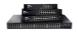
Dell Networking Enterprise Switch Positioning
Ent. Campus LAN
Data Center
Chassis Agg
DC Core
Fixed Port Campus Agg
C150/300
DC / TOR
E600i & E1200i
Z9000
PCT 8024
Campus Edge
Price-Performance
PCT 7000
S60
S4810
S55
Force 10 OS
PCT 6200
MXL
PCT 5500
J-SRX650 (FY13)
PCT 3500
J-SRX220 (FY13)
S25N/S50N S25V/S50V
S25P
PCT 2800
J-SRX100/210/240
Open Management
Functionality
Notes:
MAIN MESSAGE: Show the new Dell portfolio and demonstrate a few key aspects:
* All of the Force10 family use the same operating system, called FTOS, or Force Ten Operating System. FTOS is a battle-tested operating system that is built in open networking standards and protocols. FTOS also features an industry standard command line interface. This means that as customers who currently use the Cisco platform will have very little learning curve when incorporating Force10 into their environment. Force10 switches are categorized into three families: The S, C, E, and Z series.
S-Series: ToR, layer 3 switches that offer customers best-in-class connectivity for their network edge. The models within the S-Series are used from client connectivity up to mid-range server connectivity and offer features such as ultra-low latency data movement, huge buffer capacity up to 1.25GB, and Power-Over-Ethernet. The S-Series includes both 1Gb and 10Gb connectivity options and have uplink options up to 40Gb to give customers high throughput connection options to uplink their top-of-rack S-Series switches into larger core devices.
C-Series: Entry to mid-level chassis based switching. Customers often use chassis switches to aggregate many connections from the top of each rack into a single platform that offers a single point of management and a single point of advanced routing. The C-Series offers up to 384 ports and uses line cards to enable multiple connectivity options including 1Gb ports, 10Gb ports, and Power-over-Ethernet ports and up to 1.5Tbps of switching capacity.
E-Series: Mid to high-level chassis based switching for customers who have very large datacenters and need very dense core level aggregation of both top-of-rack and other chassis switches. The E-Series offers up to 1260 ports, supports the most advanced routing protocols, and offers up to 3.5Tbps of switching capacity. Line cards are available for the E-Series that include 1Gb ports, 10Gb ports, and 40Gb ports.
Z-Series: Building out a large datacenter, using what is called a distributed core. Unlike large chassis models, the Z9000 offers up to 32 40Gb ports or 128 10Gb ports in an ultra dense, 2U form factor. These ports are used to uplink other chassis or top-of-rack switches into the core. The Z-series is often used by customers with large environments who want to get the best total cost of ownership from their datacenter investment. The Z9000 offers up to 2.5Tbps of throughput in 1/10th the footprint of the competitive Cisco model, 1/5th the price, and it uses 1/20th the power.

Slide 15
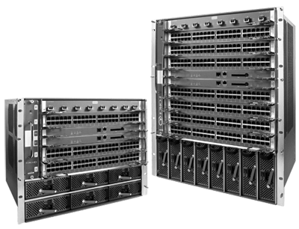
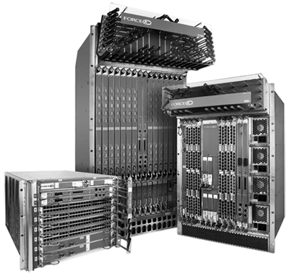

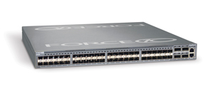
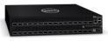
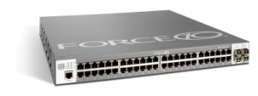
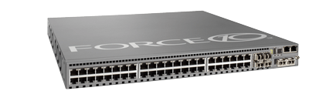
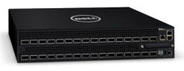
Feature-rich software innovation FTOS software maximizes data center networking functionality
Hardware abstraction layer
Proven
Reliable
Flexible
Routing
Switching
Management
Security
Virtualization
3rd party apps
Modular FTOS
S-Series
TOR/Access Systems
C-Series
Aggregation Systems
E-Series
Core Systems
Z-Series
Distributed Core Systems
Common software functionality across all platforms

Slide 16
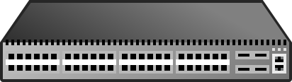
Open Automation framework Simplifying the complex
BARE METAL PROVISIONING
Virtual Server Networking
Automatically configure network switches
Automate VM/VLAN migration
1-2-3
Run Perl & Python scripts on network switches
Enable 3rd party management tool sets
SMART SCRIPTING
PROGRAMMATIC MANAGEMENT

Slide 17
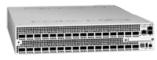
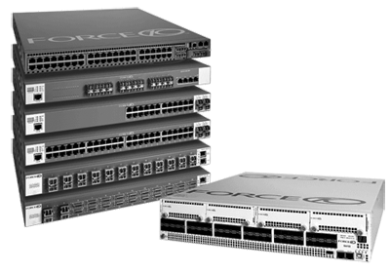
Force10 Product Family
Z-Series
Large DataCenter
Relevance: Large Core; ultimate scalability and TCO
E-Series
Large Chassis
Relevance: Large Datacenter Core
C-Series
Mid-Range Enterprise
Relevance: Med-Sized Datacenter Core
S-Series
Entry/Top-Of-Rack
Relevance: All Networks
2U Distributed Core Switch
40GbE Ethernet (100GbE coming!)
Up to 32 40GbE ports or 128 10GbE Ports
Layer 3
Up to 2.5Tbps switching capacity
Up to 4000 VLANs
Routing: RIP, OSPF, BGP, IGMP, PIM
Competitive Position:
1/10th the footprint
1/5th the price
1/20th the power
Mid to High level Chassis Switching
1/10/40Gb Ethernet
Up to 1260 ports
Layer 3
Up to 3.5Tbps switching capacity
Up to 4000 VLANs
Routing: RIP, OSPF, IS-IS, BGP, IGMP, MLD, PIM, MSDP, RSVP-TE, LDP
Top-Of-Rack Switches
1/10Gb Ethernet
Up to 48 Ports
Stacking Capabilities
PoE Capabilities
Layer 3
Up to 4000 VLANs
Ultra-Low Latency
Ultra Deep Buffer
Routing: RIP, OSPF, BGP, IGMP, PIM
Redundant Power Options
Entry to Mid level Chassis Switching
1/10Gb Ethernet
Up to 384 Ports
Layer 3
Up to 1.5Tbps switching capacity
PoE Capabilities
Up to 4000 VLANs
Routing: RIP, OSPF, BGP, IGMP, PIM
Data Center Size
Performance

Slide 18
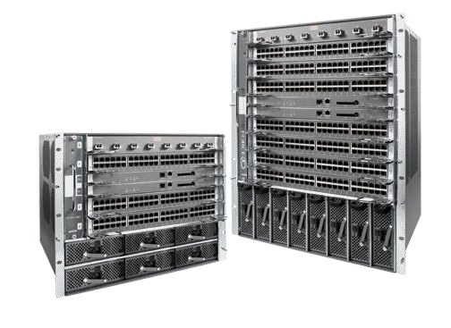
C-Series chassis systems
Resilient chassis-based switches for Data Center EoR, Aggregation & Campus Core
Cost effective 10GbE trunking
Low-cost server aggregation
Cost-effective IEEE 803.2af Class3 PoE enabled 10/100/1000Base-T for VoIP phones, wireless access points & video cameras
C300
C150
C-Series

Slide 19
C-Series comparison
Features | C150 | C300
Switch Fabric Capacity | 768Gbps | 1.536Gbps
10/100/1000Base-T | 192 | 384
Line-rate 10/100/1000Base-T | 192 | 384
10GbE | 32 | 64
Line-rate 10GbE | 32 | 64
Chassis Height (RU) | 9 | 13
Line Card Slots | 4 | 8
MAC Entries | 256K | 512K
Max Routes (IPv4 / IPv6) | 12K / 6K | 12K / 6K
IPv4 Routing | RIP,OSFP,BGP | RIP,OSFP,BGP
IPv6 Routing | OSPF,BGP | OSPF,BGP
Multicast Routing | IGMP,PIM | IGMP,PIM
Use Case | Aggregation / EoR / Core | Aggregation / EoR / Core
C300
C150
C-Series

Slide 20
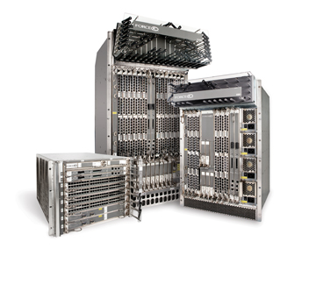
E-Series chassis systems
Resilient chassis-based switches for Data Center Core, Campus Backbone & Carrier Exchange Points
Low TCO with non-blocking line-rate throughput
Integrated automation & virtualization support
400Gbps-3.5Tbps switching fabric
E1200i
E600i
E300
E-Series

Slide 21


Z9000 core system Peak performance, rock-bottom economics
Scaling the data center core up, down & out
2.5Tbps in 2RU footprint
High-density networking
32 line rate 40GbE or
128 line rate 10GbE
Low power consumption
800 Watts Max (6.25W per 10GbE)
600 Watts Typical (4.68W per 10GbE)

Slide 22
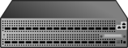

Distributed core architecture with Z9000 Scalable data center fabric solutions
Scaling out the core
Z9000 Spine
Z9000 Leaf
Distributed Core
Architecture
Massively scalable, ultra-reliable leaf-spine fabric architecture
Low-latency, non-blocking performance to 160Tbps (theoretical max)
Layer 3 (OSPF/BGP) control plane
Z9000
READ THE REPORT:
Distributed Core Architecture www.force10networks.com/tollyreport

Slide 23
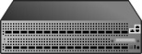

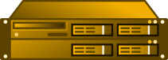
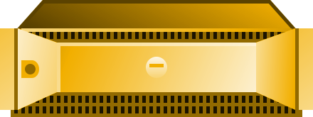
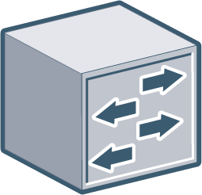


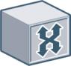
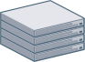

Network Simplification with Z9000 Enabling simpler, flatter networks
Fabric Design
Spine
Distributed Core Fabric
Leaf
10 GbE
Core
Conventional Design
10GbE
10 GbE
Aggregation
1/10 GbE
Top-of-Rack
Z9000
1 GbE
23

Slide 24
Distributed core design options Fabrics for any size data center
16 x 32 - 40G Non-Blocking Distributed Core
2 x 4 - 10G Non-Blocking Distributed Core
Z9000 Spine
S4810 Spine
16
40G Interconnects
10G Interconnects
Z9000 Leaf
S4810 Leaf
32
Fabric capacity - 40.96 Tbps
Up to 2,048 10GbE or 512 40GbE ports
Fabric capacity - 2.56 Tbps
Up to 128 10GbE ports
Build a distributed core fabric that fits your needs
4 x 32 - 40G Over-Subscribed Distributed Core
4 x 12 - 10G Over-Subscribed Distributed Core
Z9000 Spine
S4810 Spine
40G Interconnects
10G Interconnects
S4810 Leaf
S4810 Leaf
32
12
Fabric capacity - 10.24 Tbps
Up to 1,536 10GbE ports
Fabric capacity - 3.84 Tbps
Up to 576 10GbE ports
24

Slide 25
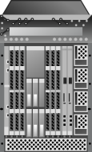
Conventional core vs. Distributed core
Conventional Core
Distributed Core
Spine
VS.
Leaf
Distributed Core benefits
Massively scalable, leaf/spine architecture
Fabric capacity scales to 160Tbps (theoretical)
Line-rate, non-blocking performance
Highly resilient design
Low power systems boost energy efficiency at scale

Slide 26
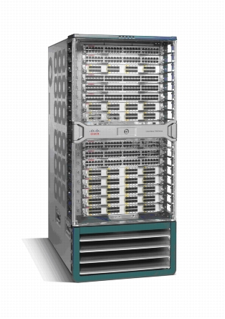

Dell Z9000 vs. Cisco Nexus 7018
For a 1536 10GbE port data center design, Dell Z9000 consumes 1/4th the power, is 1/5th the price
and requires 1/6th the packaging compared to Cisco Nexus 7018.
Cisco Nexus 7018
Dell Z9000
2 x Nexus7018
4 x Z900 - Spine
40GbE
Nexus3016
ToR
S4810
ToR/Leaf
40GbE
…32
…32
1536 Servers
…32 Racks
1536 Servers
…32 Racks
1/4
Power
1/5
Cost
1/6
Packaging

Slide 27
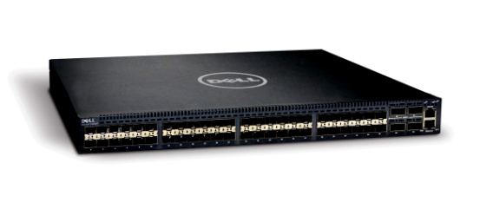
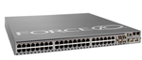
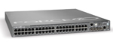
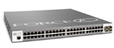
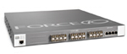
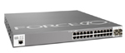
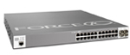
Data Center top-of-rack systems
10/40GbE
S4810
S60
Price
S55
S50V
S25P
S50N
1/10GbE
S25V—PoE
S25N
Performance

Slide 28
S55 & S60 1/10 GbE Top-of-Rack
Data Center Core
Data Center Core
1/10GbE
1/10GbE
S55
Low-Latency
Top-of-Rack
S60
Deep-Buffer
Top-of-Rack
S55
S60
Low-latency Gigabit Ethernet
48x1GbE + expansion slots
Integrated automation & virtualization support
Deep-buffer Gigabit Ethernet
48x1GbE + expansion slots
Integrated automation & virtualization support

Slide 29

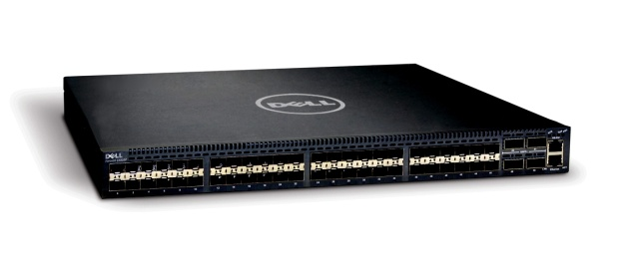

S4810 10/40 GbE Top-of-Rack or Core
Data Center Core
Ultra-Low Latency
10/40G Ethernet
10/40GbE
S4810
10/40GbE Top-of-Rack
S4810
Ultra-low-latency 10/40 GbE
64x10GbE or 48x10GbE + 4x40GbE
Integrated automation & virtualization support

Slide 30
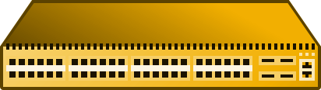
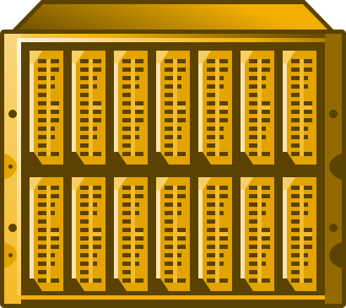
Introducing Dell Force10 MXL Switch Networking blade for M1000e blade chassis powered by Force10
NEW!
Dell Force10 MXL Switch
Industry’s FIRST 40G blade switching solution
High-density 1/10G + 40G
Built on Force10 technology & powered by FTOS
Optimized for:
Performance
Efficiency
Storage
S4810-class horsepower & features powered by FTOS
Integrated 1/10/40G switching
M1000e & Force10 MXL switch

Slide 31

Architected for Performance Improve intra-chassis performance with local switching
Without Local Switching
With Local Switching
Top-of-Rack Switch
Top-of-Rack Switch
4x fewer ToR ports
= More ToR ports
=
West
East
West
East
All intra-chassis East-West traffic (blade-to-blade/VM-to-VM) sent to Top-of-Rack switch
All intra-chassis East-West traffic processed locally for improved performance

Slide 32
Designed for efficiency Reduce uplink ports & cabling with 40G
10G Connectivity
40G Connectivity
Top-of-Rack Switch
Top-of-Rack Switch
More ToR
ports @ 10G
4x fewer ToR ports @ 40G
=
=
Using 10G port requires more ToR ports, more cables, more hassle
Using 40G port requires less ToR ports, less cabling, less headaches

Slide 33

Optimized for Storage Simplify infrastructure with DCB & FCoE support
BEFORE
AFTER
iSCSI or FCoE
Ethernet
Switching
SAN
LAN
Lossless Ethernet
M1000e w/ MXL switch
DCB Enabled
Discrete LAN & SAN Networks
Converged Infrastructure

Slide 34




Dell’s Solution Strategy for Networking
Simplify the Network
Build on What You Have
Notes:
At Dell, there are two basic tenets that drive our solution strategy around networking. The first is to help customers simplify their networks. The second is to empower them to build on what they have.

Slide 35
Value Proposition
Affordable
Simple to deploy
& manage
Supports standards
Best-in-Class
No vendor lock-in
Quality
Redundancy
Compatible
Open
Standards-based
Scalable
Dependable
End-to-end
Integration
Scalability &
Automation
Easy to use
Leverage existing investments
Notes:
In conclusion, Dell has the networking solutions to help you meet the challenges of network planning, deployment, and management for the Virtual Era. Dell is fundamentally changing the status quo for networking by embracing new networking paradigms and trends such as virtualization , cloud computing and mobility . We demonstrate this in the areas of automating the scalability of your network, integrating our systems management tools so that you have a better user experience, and simplifying management processes overall.
We know that first and foremost you want an open environment because you don’t want to be trapped by a single vendor. So every step of the way we’re going to continue to deliver open and scalable networking solutions that increase give you more flexibility and agility. We are driving to increase operational efficiencies that address the dynamic business workloads you have today, whether they are increasing or decreasing, dramatically or otherwise.
Hardware, software, a spectrum of networking services, and the right mix of partners let empowers you to:
• Simplify your network
• Leverage your existing deployment to build on what you have by leveraging your existing deployments
• Meet changing needs easily and cost effectively
• Build for tomorrow as well as today with extensibility for tomorrow
Dell's Networking Solutions include support at every phase, from informational workshops, needs assessment and design, to implementation and ongoing support and maintenance.
Build for your future using what you have now. Simplify your network and boost agility and performance. Lower management costs and free your staff to innovate.

Slide 36








Simple, Optimized, Strategic An ecosystem of network solutions for the business ahead
PowerConnect
Servers
Storage
Dell EqualLogic
Dell PowerVault
Dell PowerEdge
Dell Compellent
Dell Services
Business Ready Configurations
Dell Networking
Business Process Services
Dell Blades
Application Services
Consulting Services
Dell Networking Solutions
Support Services
Infrastructure Services
EqualLogic
Storage
IT Hardware Infrastructure

Slide 37





Next steps
Talk to us today about your challenges and needs!
Request product evaluations
Request Customer References
3. Attend more events and workshops. www.dell.com/smb/webcasts
4. Visit our online solutions center:
www.dell.com/business/solutions

Slide 38
Thank You!

